Slide 1



Curriculum Information for Website
Physical Education

Slide 2
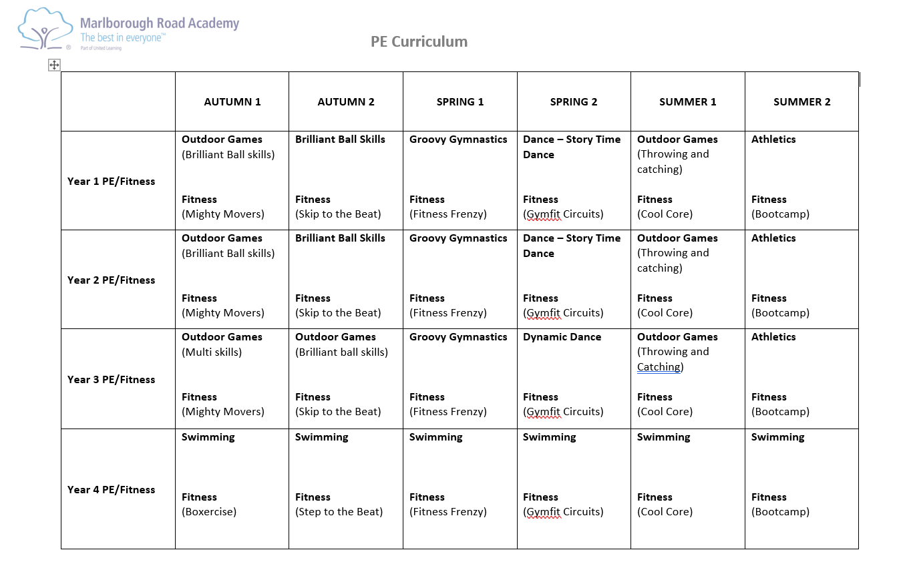
United Curriculum

Slide 3
